Slide 2
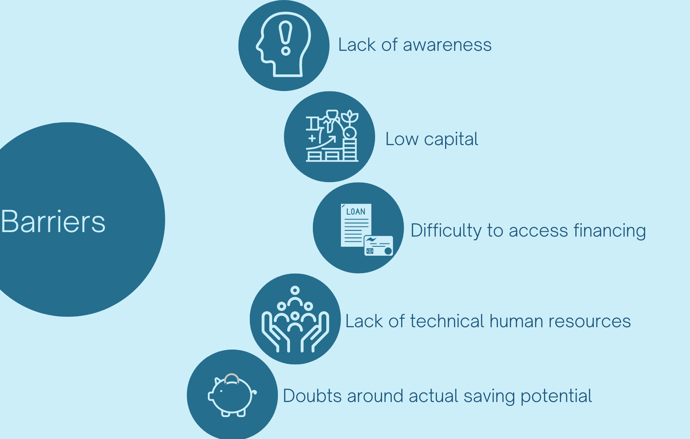


Barriers and challenges in SMEs
Additional challenges
Energy efficiency not in core business priorities of SMEs
Low energy costs (non energy-intensive SMEs)

Slide 3
Why Multiple Benefits?
Recast Energy Efficiency Directive (Art.11):
“Member States shall develop programmes with the aim of encouraging and providing technical support to SMEs […] to undergo energy audits and to subsequently implement the recommendations arising from those audits.”
“Member States shall ensure that the programmes […] include support to SMEs in quantifying the multiple benefits of energy efficiency measures”
DEESME, following the methodology developed by the M-Benefits project, aims to demonstrate how multiple benefits enhance competitiveness in SMEs by improving the value proposition and reducing risks and costs.

Slide 4
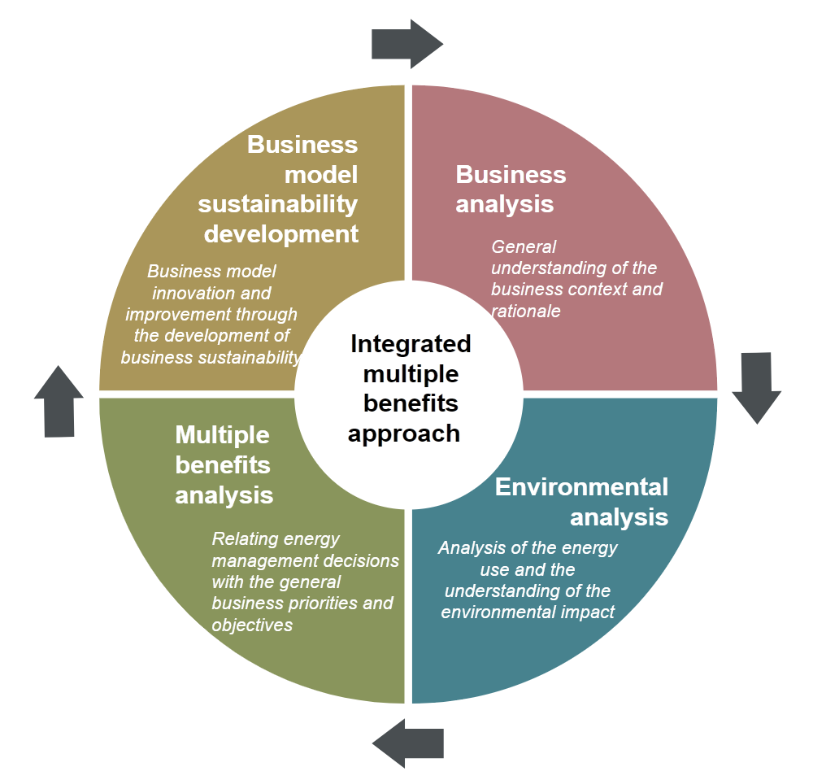
DEESME MBs Approach: Energy Audits
The methodology for audits aims to incorporate the multiple benefits in the company’s business model
It consists in a 4-stages approach starting with the analysis of the business model and ending with proposals for its improvement

Slide 5
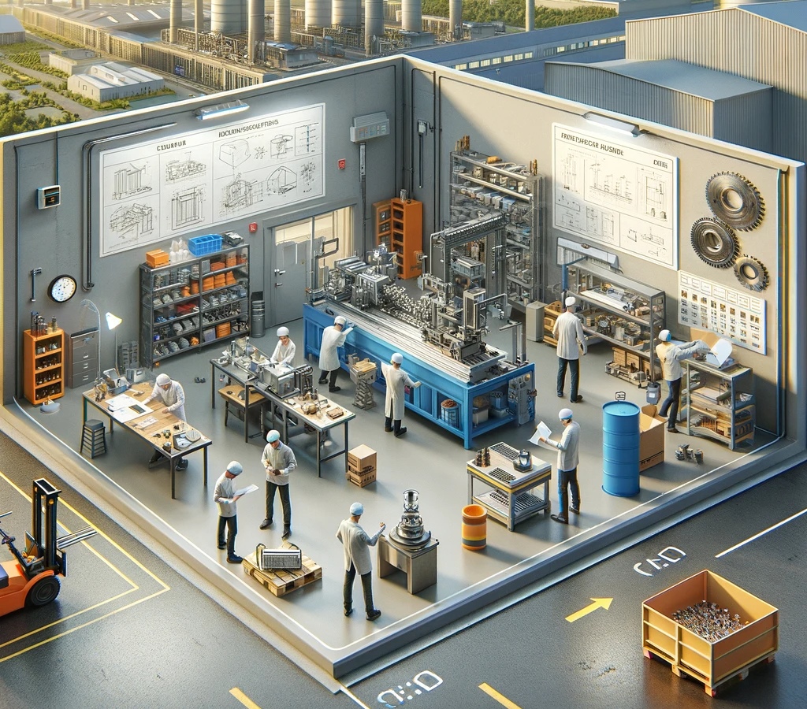
Audits Methodology:
Business Analysis
Step 1: Business Model Analysis
Analysis of value proposition, partners, customer segments, key resources, partnerships according to the Business Model Canvas
Step 2: Cost Structure Analysis
Cost centers identification in all the production processes

Slide 6
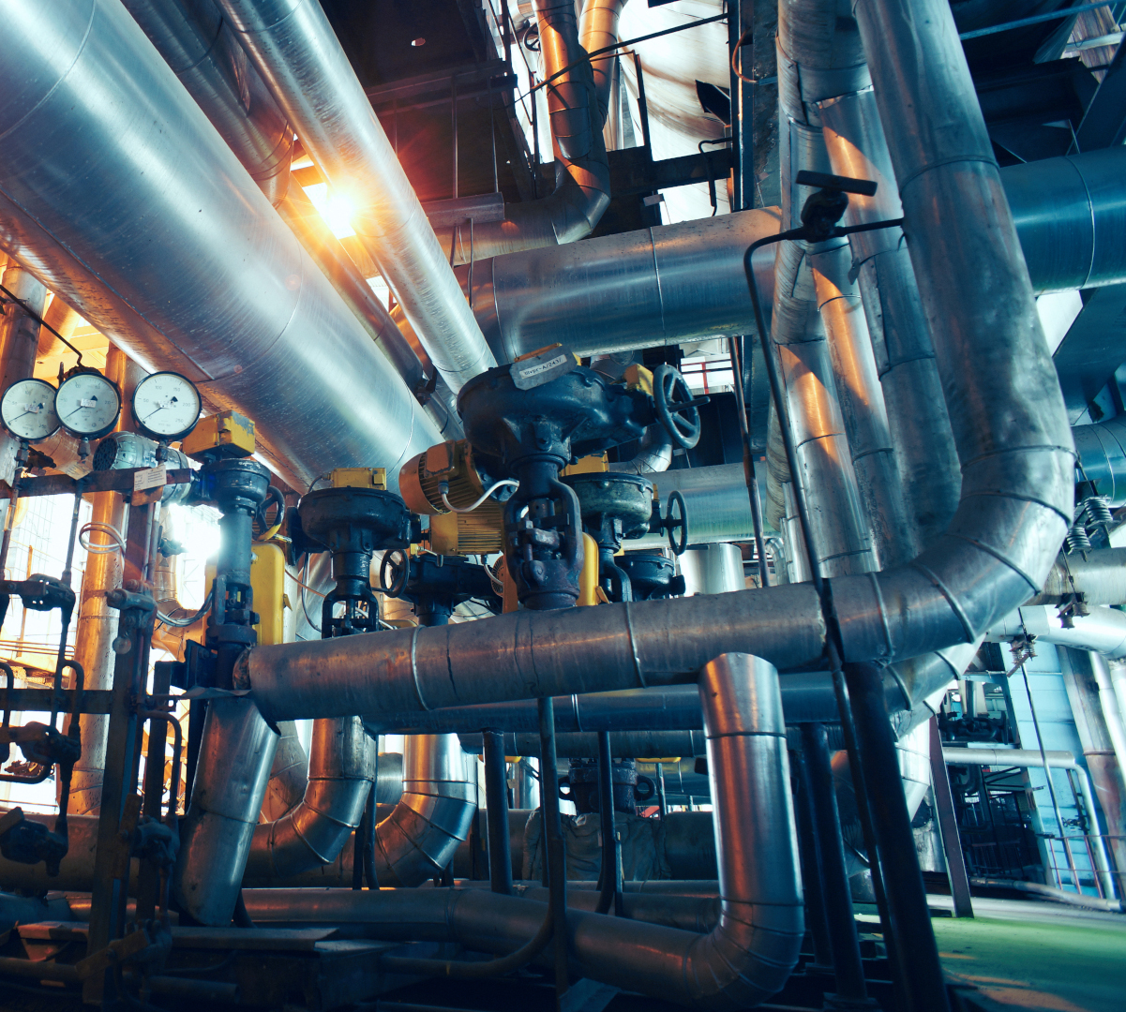
Audits Methodology:
Environmental Analysis
Step 1: Energy Auditing
Preliminary work → Data collection → On-field inspection → Identification of energy saving opportunities → Audit report
Step 2: Carbon Footprint Analysis
Estimation of Energy & Non-Energy related GHG emissions from company’s operation

Slide 7
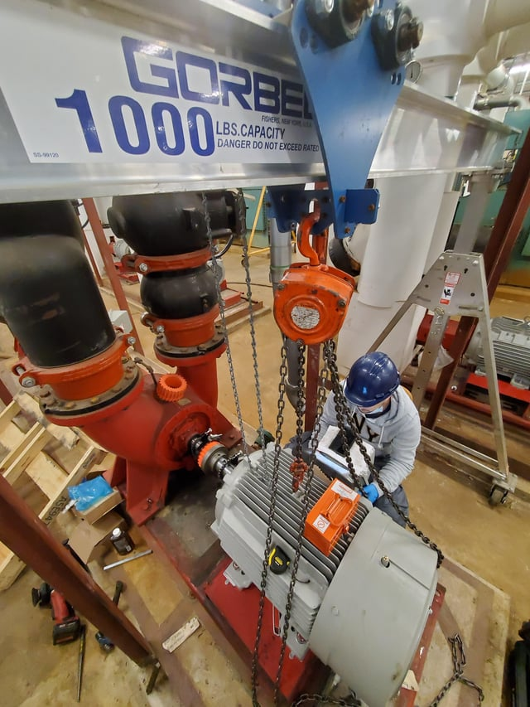
Audits Methodology:
Multiple Benefits Analysis
Step 1: MBs Identification
For each identified Benefit:
- Description
- Main MB Indicator
- Alternative Indicators
- Calculation/Quantification Method
Step 2: MBs evaluation
Attribution of qualitative scores to each MB concerning:
- Significance for the company
- Contribution to the BM
The Exploitation Plan is outlined

Slide 8
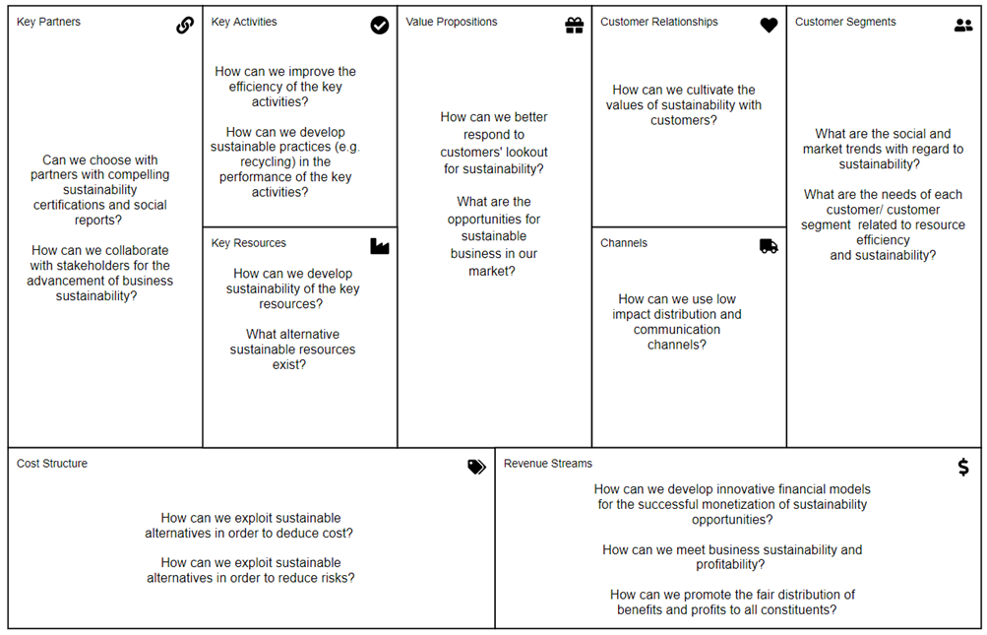
Audits Methodology:
Business Model Advancement
Business Model
Innovation & Improvement
The existing Business Model is renovated in its core elements or improved through the MBs having high positive impact.
This is done for each relevant area of the business model canvas.

Slide 9
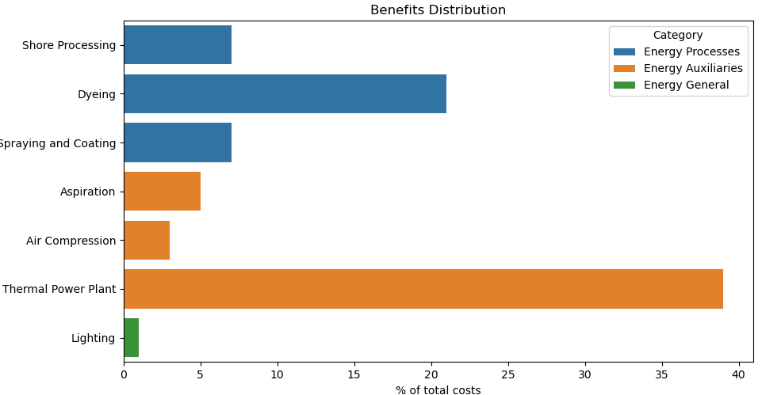
Audits Methodology: Case Study (1/4)
Value Proposition
High quality
Key Activities
Product development
Main Resources
Qualified operators
Water and energy
Machinery
Customization & flexibility
Controlled quality;
Quality control
Selection of raw materials
Customer segment
High fashion
Medium-size company – NACE 15.11 - Tanning and dressing of leather
Business model analysis
Cost structure analysis

Slide 10
Methodology for Audits: Case Study (2/4)
Medium-size company – NACE 15.11 - Tanning and dressing of leather
Energy analysis

Slide 11
Methodology for Audits: Case Study (3/4)
Medium-size company – NACE 15.11 - Tanning and dressing of leather
Multiple Benefits analysis*
Benefit | Description | Quantification
Improved maintenance | Reduced maintenance costs for old thermal plant | Evaluated based on historical costs: 15.000 €/year
Improved raw materials consumption | Diathermal oil replacement for old thermal plant | Replacement cost about 6.000 €/year
Improved raw materials consumption | Make-up water | Considering a cost of 2 €/m3, the cost of make-up water is about 1.000 €/year
Reduced carbon footprint | Loss of certification required by the supply chain | Reduction in sales quantified in at least 100.000 €/year, considering historical sales
*selected investment: revamping of thermal plant

Slide 12
Methodology for Audits: Case Study (4/4)
Medium-size company – NACE 15.11 - Tanning and dressing of leather
Business Model Advancement
Key Activities
Improved maintenance
Reduced carbon
Footprint
Value Proposition
Improved product/service efficiency
Customers
New customers
Customer satisfaction
Customer loyalty
Partners
Supply chain relationships
Litigation risk
Regulatory compliance
Key Resources
Energy consumption
Raw materials consumption
Water consumption
Employees (health and security, training)

Slide 13
Methodology for Audits: Overall results
DEESME has conducted 42 audits in Bulgaria, Italy, Germany and Poland
The area most affected by MBs are ‘activities’ and ‘resources’ (e.g. increased productivity, improved safety, improved raw material consumption)

Slide 14


Integration of MBs in the Energy Management System
DEESME developed a set of guideline aimed at incorporating Multiple Benefits in the Energy Management System
The guidelines identifies relationships between the MBs approach and the ISO 50001 standard providing specific recommendations to account for MBs in each relevant standard’s clause.

Slide 15
Integration of MBs in the Energy Management System
EnMS Guidelines
Organization and Context
Needs/Expectations of Interested Parties
Leadership & Commitment
Energy Policy
Actions to Address Risks
Competence
Awareness
Communication
Operational Planning and Control
Design
Procurement
Monitoring
Roles & Authorities
Objectives and Planning
Energy Review
Energy Indicators
Collection of Energy Data
Monitoring & Evaluation

Slide 16

Next activities
https://ieecp.org/projects/deesme2050/

Slide 17


What about micro-enterprises?

Slide 19
Backup slides

Slide 20
Energy Management System: Case Study
Small-size company – Metal elements production
In the “Plan” phase, an assessment of the attention to the MBs stemming from the interventions highlighted in the company’s energy policy was carried out.
The company declared that no attention was given to MBs in its energy policy.
The following indicators of MBs were identified by the company when assessing energy efficiency measures.

Slide 21
Energy Management System: Case Study
Small-size company – Metal elements production
Improvement Area | Metric | Expected Outcome
Improved product/service efficiency | Energy cost per unit of product/service | YES, The cost of energy per unit of production will be reduced.
Increased productivity | Value of output items/Value of input items | YES, more production with less energy consumption is expected
Increased utilization | Capacity utilization | YES, New machines are more efficient.
Reduced Carbon Footprint | Total GHG emission per year | YES, The carbon footprint will decrease.
Reduced energy consumption | Total energy consumption per year | YES, Annual final energy consumption will be reduced.
Increased recycling | Percentage of total waste that is recycled | YES, with a new scrap cutting machine
Increased customer satisfaction | Satisfied customer share | YES, an increase in customer satisfaction is expected

Slide 22
Energy Management System: Case Study
Small-size company – Metal elements production
In the “Do” phase the analysis and resolution of potential critical issues is conducted.
The criticalities identified by the company were potential behavioral issues by the personnel involved in the energy management process and technological changes affecting the organization of work.

Slide 23
Energy Management System: Case Study
Small-size company – Metal elements production
In the “Check” phase, the companies plan the implementation of periodic monitoring of the results concerning MBs.
Parameters such as electricity consumption, LPG and diesel consumption, as well as the increase in the number of customers and their level of satisfaction are monitored. On the basis of the above-mentioned values, the values of the parameters of many benefits are determined

Slide 24
Energy Management Systems: Case Study
Small-size company – Metal elements production
In the “Act” phase, the outcomes of the previous phases are reviewed and exploited to implement concrete actions.
The company aims to assess the progress and benefits of EnMS implementation, and then perform the energy audit again and possibly make changes in the production process.

Slide 25
Measures implementation
Probability of implementation | BG | DE | IT | PL
1. Already planned/implemented | 8 | 0 | 2 | 10
2. High | 21 | 17 | 12 | 15
3. Medium | 8 | 0 | 10 | 7
4. Low | 0 | 15 | 2 | 17

Slide 26
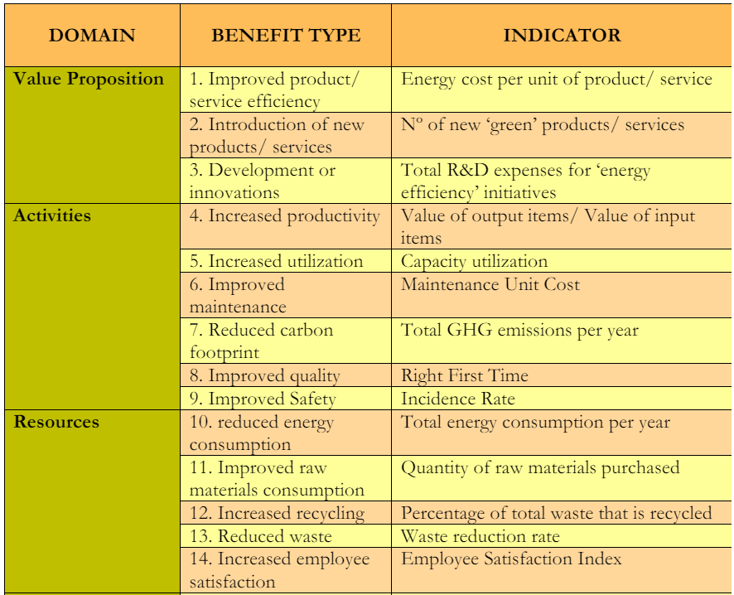
MBs indicators (1/2)

Slide 27
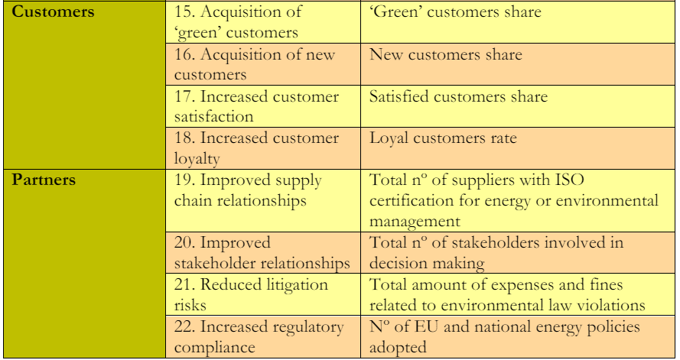
MBs indicators (2/2)

