Slide 1


Significant electricity savings with info nudging during the energy crisis in Finland
Leila Timonen, Päivi Suur-Uski
Campaign for public awareness and action in Finland
Oct 2022 – April 2023

Slide 2

Motiva – a Sustainable Development Company
Speeding up the shift towards a
sustainable society and lifestyle.
Motiva is an effective and impartial
builder and leader of sustainable ecosystems.
We bring together public,
private and third sector actors
to develop and implement
new scalable solutions.
100%
State-owned sustainable development company
Sustainable Development Goals

Slide 3

Why?
harm caused by the war to the energy market
rapid rise in energy prices
uncertainty about the sufficiency of electricity during the heating season
How?
a widely reaching campaign with a simple storybackground and means for quick energy saving measures
joint responsibility and the possibility of being
a part of solution in combating the threat
Who?
main responsibility in the Ministry of Labor and Economy, strong investment by the Energy Authority
the coordination of the campaign was managed by Motiva, a state-owned sustainable development company that provides energy advice to households
Motiva, the Ministry of Economic Affairs and Employment of Finland, the Ministry of the Environment,
the Prime Minister’s Office, the Finnish Innovation Fund Sitra

Slide 4
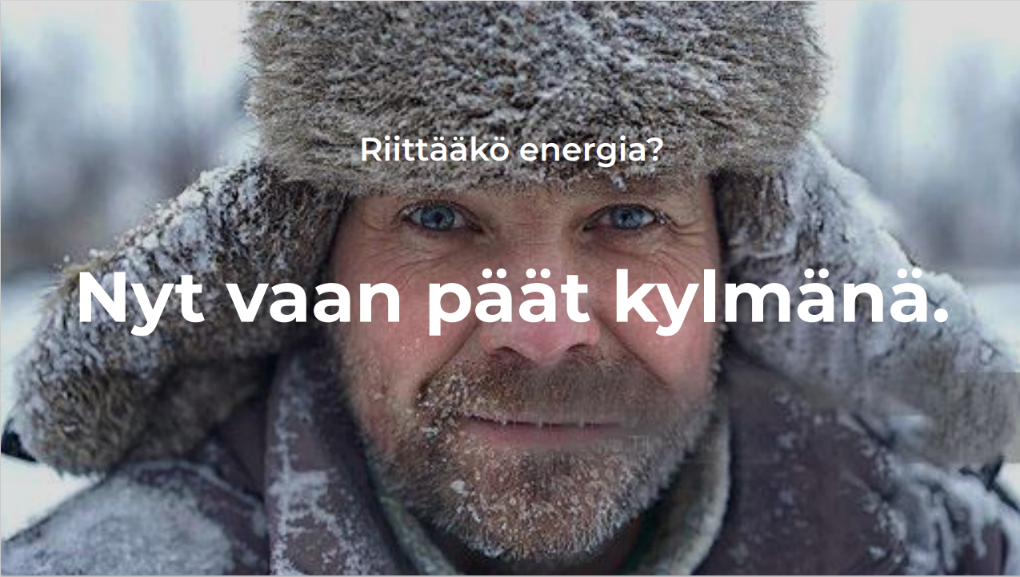
Will there be enough energy?
Now it is time to keep it cool.
Notes:
This picture evokes strong emotions in Finns. It represents the nation's collective memory of the reconstruction period after the wars. This was, of course, a carefully chosen line of communication to prepare Finns for the heating season and energy saving.

Slide 5
Short-term goal
Energy saving and balancing out peaks
in energy consumption.
To ensure there will be enough energy
for all of us.
To get over 95% of Finnish households to save energy and cut down on their consumption by 5% during peak hours.
Long-term goal
In the long term, the aim is to
permanently lower energy consumption and make Finnish
homes energy-efficient.
Temporal control of electricity usage based on supply and price.

Slide 6
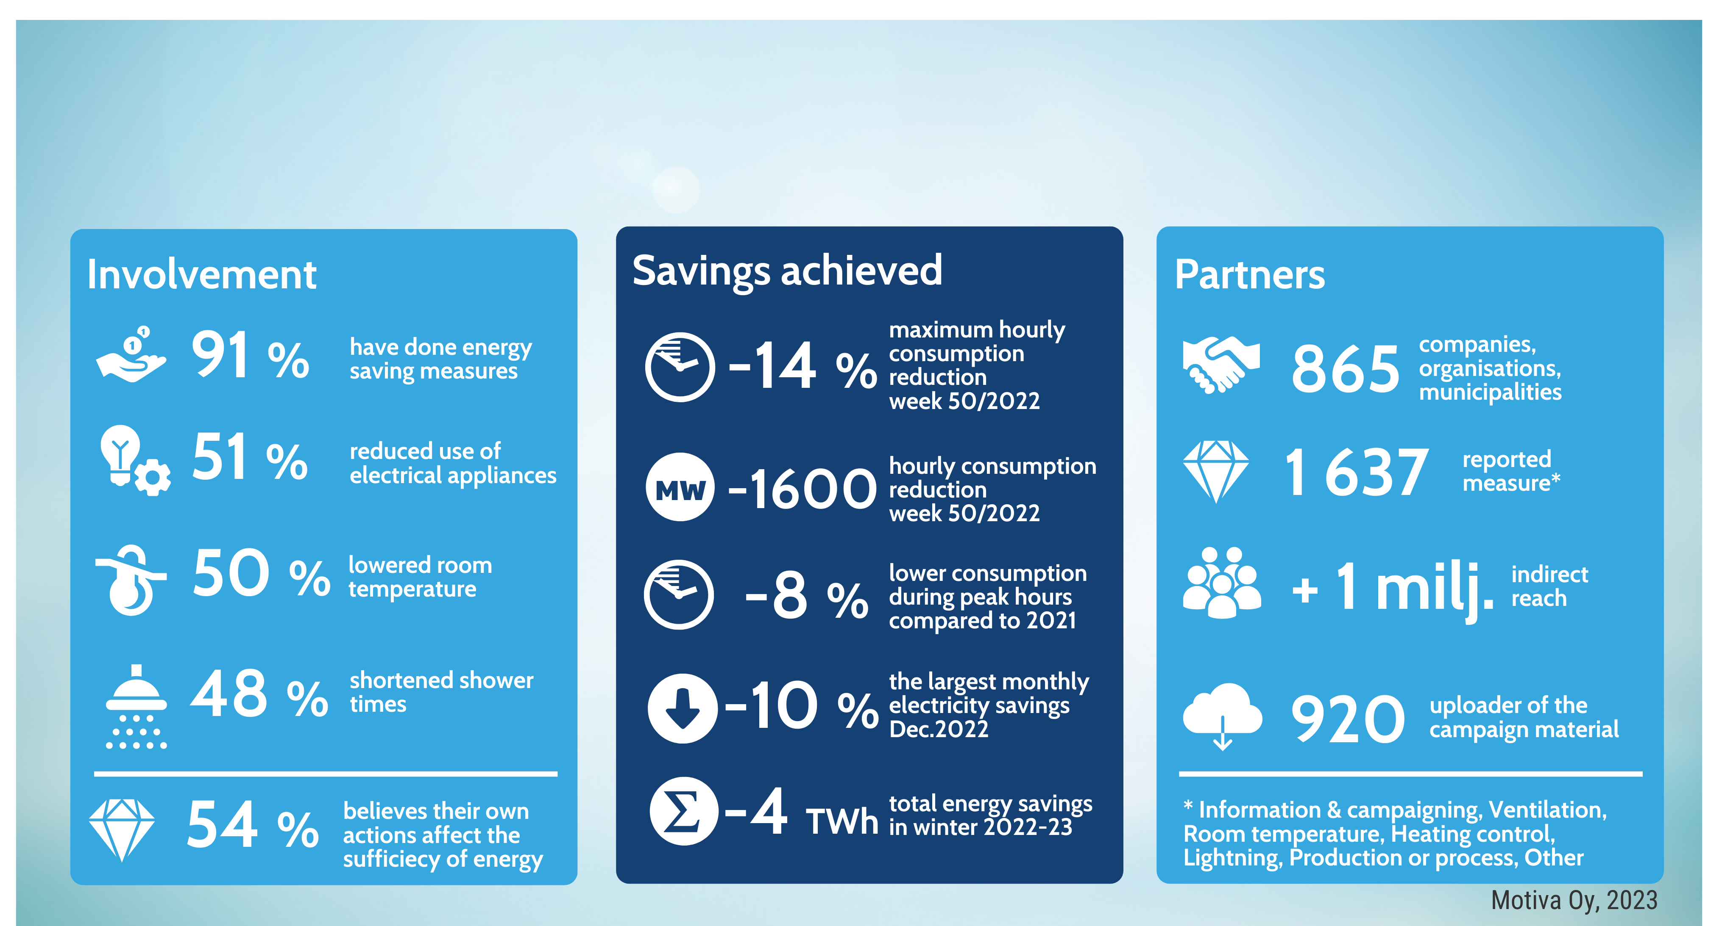
Results

Slide 7
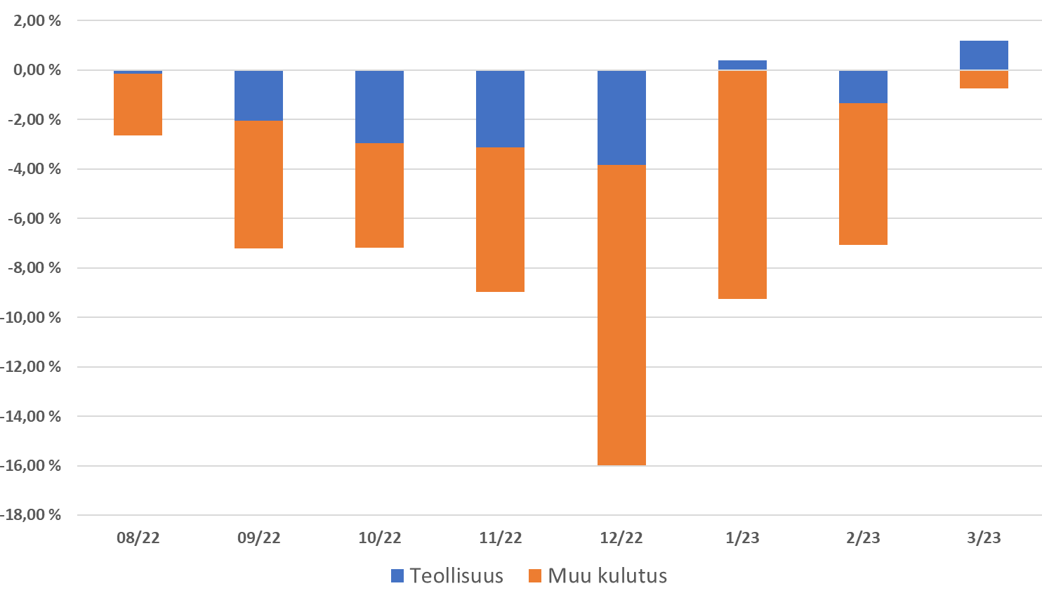
Change in electricity consumption, industry and other consumption compared to the time of the previous year
"The reduction in electricity consumption, particularly in the
winter months, has had a very significant impact on how we have coped so far with some of the more challenging periods in terms of electricity sufficiency.“
Tuomas Rauhala, Unit Manager at Fingrid,
Finland’s transmission system operator
(January 2023)
Industry
Other consumption
Source: The Finnish Energy

Slide 8
What do Finns think about
energy saving now?(Survey 9/23)
Assessment of the Importance of
Energy Saving
7,7
scale 1-10
89 %
Follows the price of electricity
at least occasionally
60 %
Households whose
electricity contract
was renewed in
March 2022
or later
60 %
Learned new ways
of energy-saving
during the
crisis winter
40%
Enjoys saving
energy
78 %
the authority
should guide people to act correctly
33%
Household’s
price based
on market
electricity
51 %
Learned to use
electricity flexibly
at different
times
72 %
accepts that campaigns are intended to influence individual actions
32 %
Constantly monitors
the price of electricity
Only
12 %
Use the information of the price to time their heating or cooking
39 %
Expect the price of electricity to return to the pre-crisis level

Slide 9
We succeeded because of
tradition of cooperation and trust
& sisu (Finnish guts)
Decades of cooperation between the state administration, industry associations and companies - ready-made networks and contacts
Launching the campaign through organisations, with the support of energy advisors - familiar method of operation from the Energy awareness week
Strong message, clear instructions, practical savings tips
Finns saved for economic reasons, but also for principle:
they recognized a common external threat.
Energy saving was done for the common good.
(Survey 9/23, Kantar Public, Motiva)

Slide 10
Kiitos

Slide 11
How do Finns experience the energy winter 2022–23? (Survey 9/23)
Finns saved for economic reasons, but also for principle: they recognized
a common external threat. Energy saving was done for the common good.
76 % blame Russia and its initiaited war for the deterioration of the energy situation.
The older age groups and men, however, blame electricity companies for the rise in electricity prices, with a total of 52 % of respondents doing so.
5 % of Finns are critical and deny
the energy crisis.
The energy market situation was closely monitored. The situation permanently changed one's own and the immediate circle's attitude towards energy consumption.
The energy situation also caused stress, and the price increase raised concerns about the sustainability of one's own finances. Women experienced the situation as more difficult than men.

Slide 12
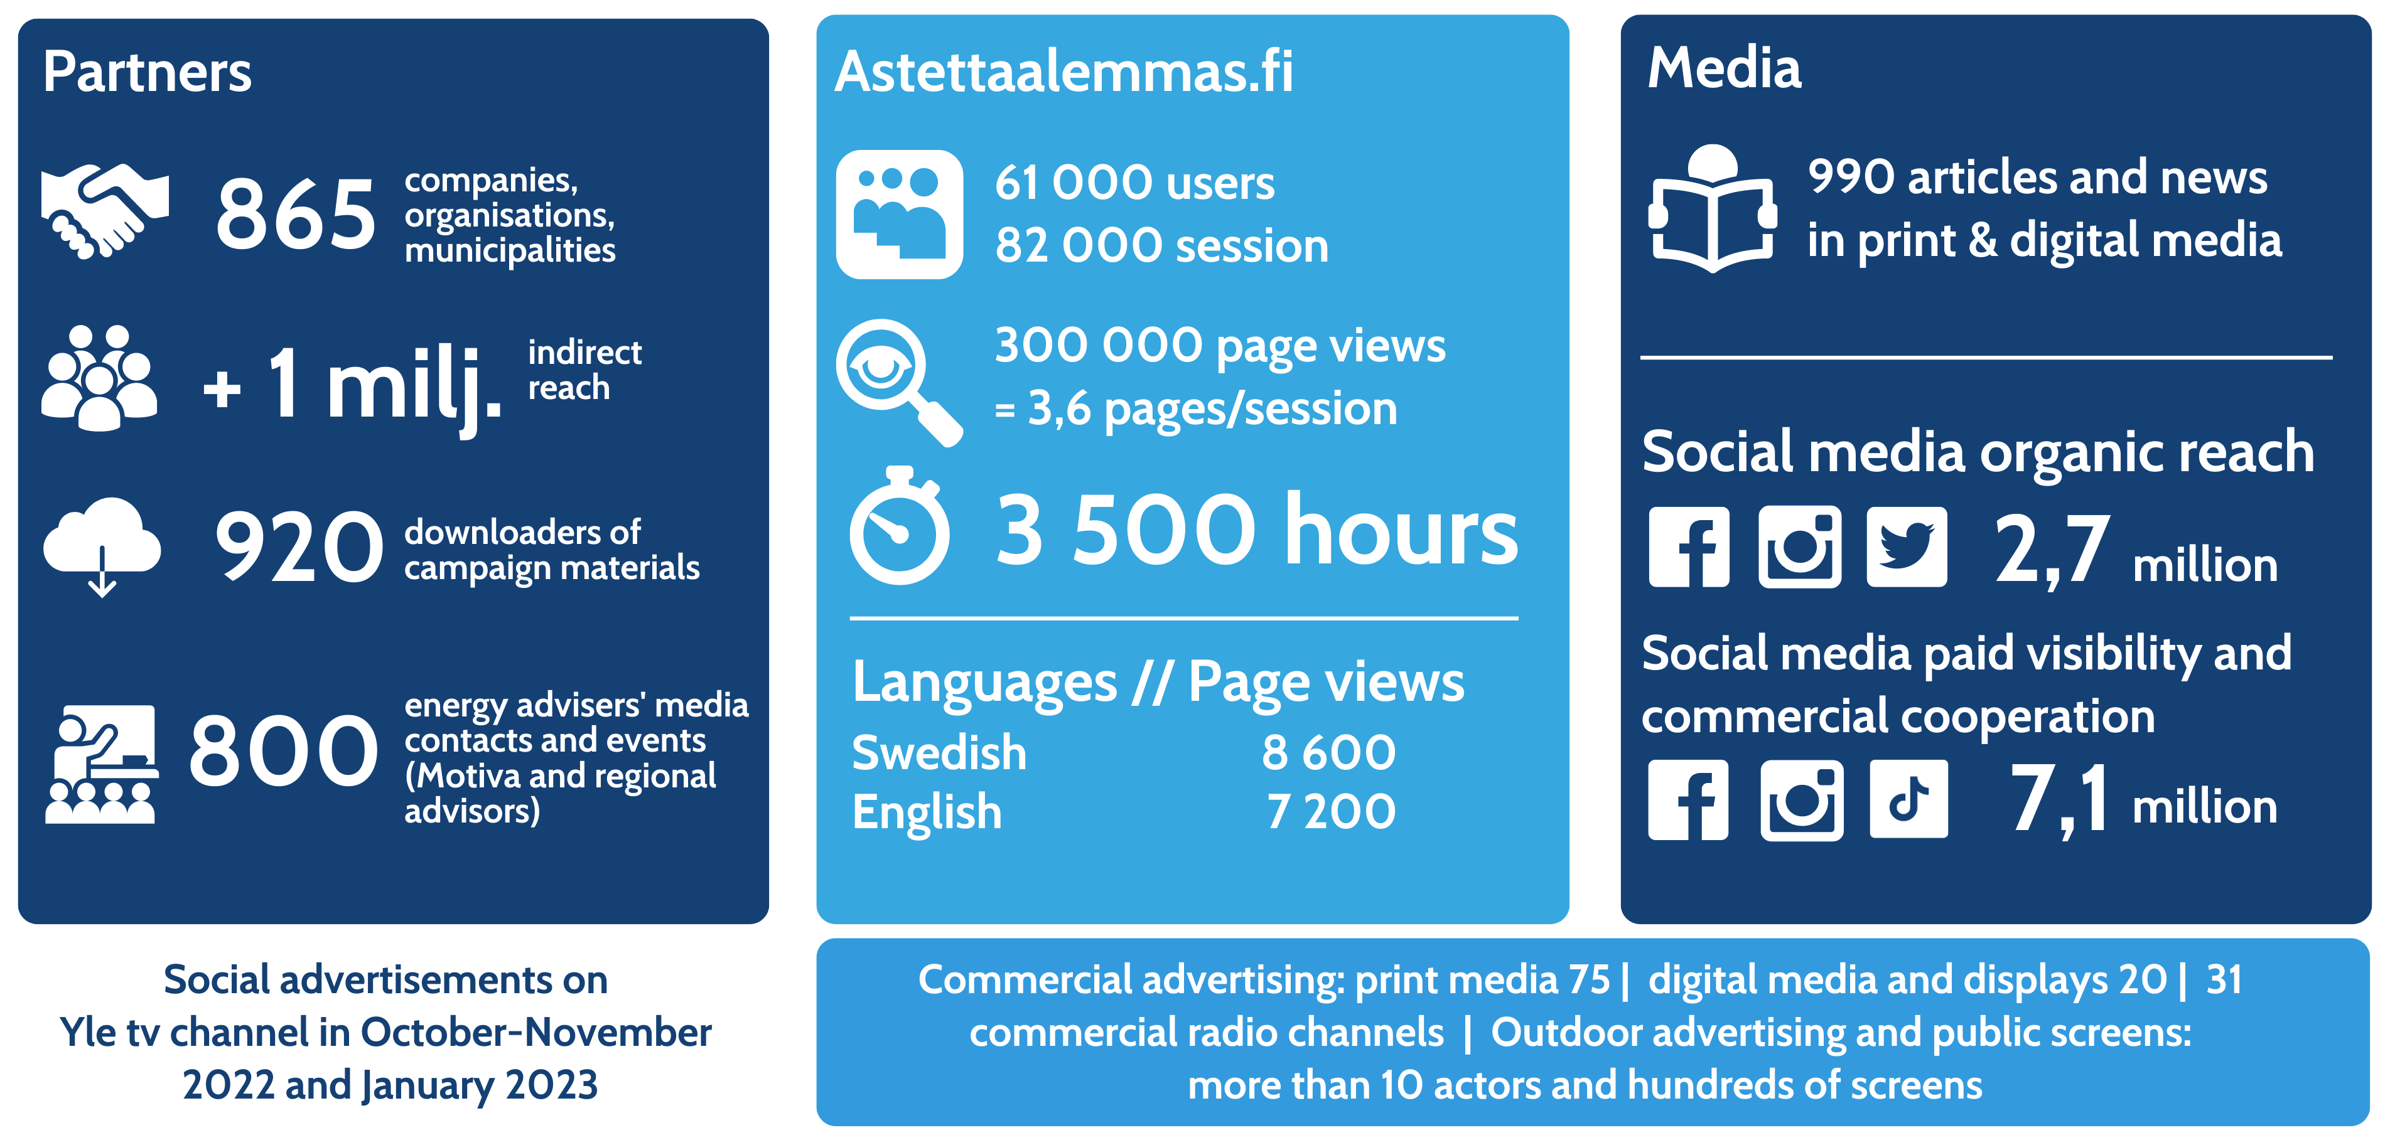
Campaign reach (population 5.6 million)

