Slide 1
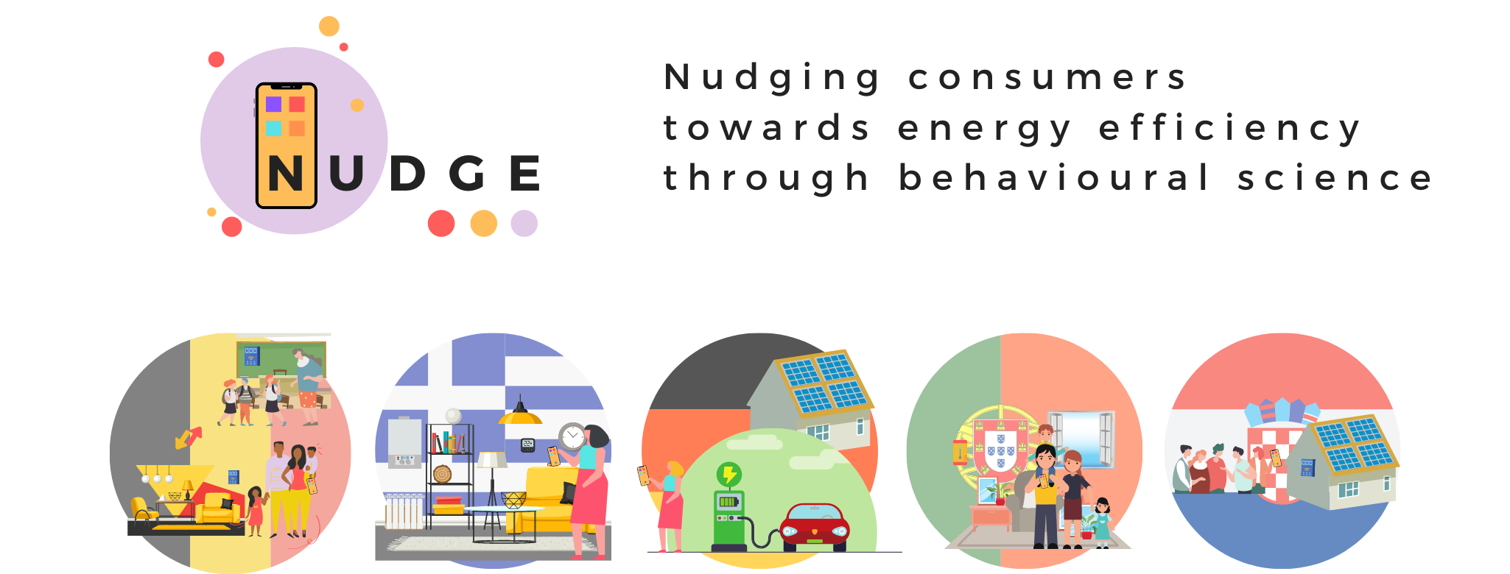
Behavioural science for energy efficiency
Insights and policy recommendations from the NUDGE project
Filippos Anagnostopoulos, IEECP
NUDGE Project Coordinator
27 November 2023

Slide 2
Behavioural science for energy efficiency
11.7% Energy efficiency target compared to the projected energy use for 2030 (based on the 2020 reference scenario) | 763 Mtoe Final energy consumption | 992.5 Mtoe Primary energy consumption
Households account for 27% of final energy consumption in the EU in 2021, with natural gas being a major energy source.
The 2022 energy crisis highlighted the urgent need for effective energy-saving measures, especially for households facing rising energy bills.

Slide 3

Revised Energy Efficiency Directive (EU/2023/1791)
‘energy efficiency improvement’ means an increase in energy efficiency as a result of any technological, behavioural or economic changes
Article 22 (Information and awareness raising) lists a range of instruments and policies to promote behavioural change such as:
(a) fiscal incentives;
(b) access to finance, vouchers, grants or subsidies;
(c) publicly supported energy consumption assessments and targeted advisory services and support for household consumers, in particular people affected by energy poverty, vulnerable customers and, where applicable, people living in social housing;
(d) targeted advisory services for SMEs and microenterprises;
(e) informationprovision in accessible form to people with disabilities;
(f) exemplary projects;
(g) workplace activities;
(h) training activities;
(i) digital tools;
(j) engagement strategies.

Slide 4
Revised Energy Efficiency Directive (EU/2023/1791)
ANNEX V : COMMON METHODS AND PRINCIPLES FOR CALCULATING THE IMPACT OF POLICY MEASURES
deemed savings, an ex-ante approach based on the results of previous independently monitored energy improvements in similar installations.
metered savings, an ex post approach whereby the savings are determined by recording the actual reduction in energy use, correcting for occupancy, weather, etc
scaled savings using engineering estimates
surveyed savings which is used only for savings resulting from changes in consumer behaviour ( response to advice, information campaigns, labelling or certification schemes or smart metering )

Slide 5
Nudging as a tool for Energy Efficiency
Nudges are subtle changes in the decision-making environment that predictably alter behavior without restricting options or significantly altering economic incentives.
They preserve choice and support individuals in making better decisions.
Nudges can involve immediate changes in the decision context (like prompts when adjusting heating) or more indirect ones (like showing average national consumption on bills).
The effectiveness of various nudges—such as social comparisons, feedback, and defaults—is a subject of ongoing research and debate.

Slide 6
How to evaluate behavioural interventions
NUDGE has systematically assessed and generated insights that help to unleash the potential of behavioral interventions for energy efficiency;
Its methods and experience contribute to the generalized use of behavioural interventions as an addition to the policy-making toolbox.
Achieved objectives
Behavioral interventions tailored to individual psychological and contextual variables.
Extensive field trials, implementing mixes of behavior-based interventions
A research protocol to measure the impact of the implemented behavioral interventions.
Recommendations towards policy makers and relevant stakeholders.

Slide 7
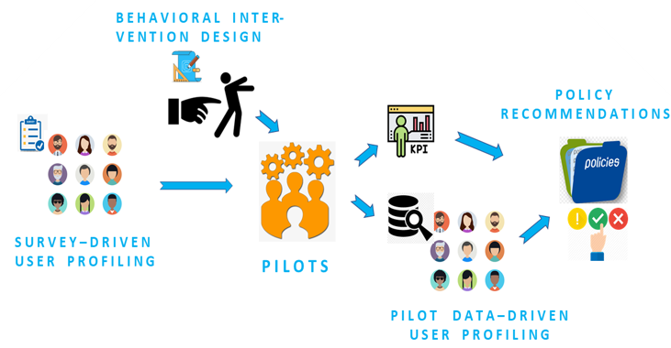
Project design

Slide 8
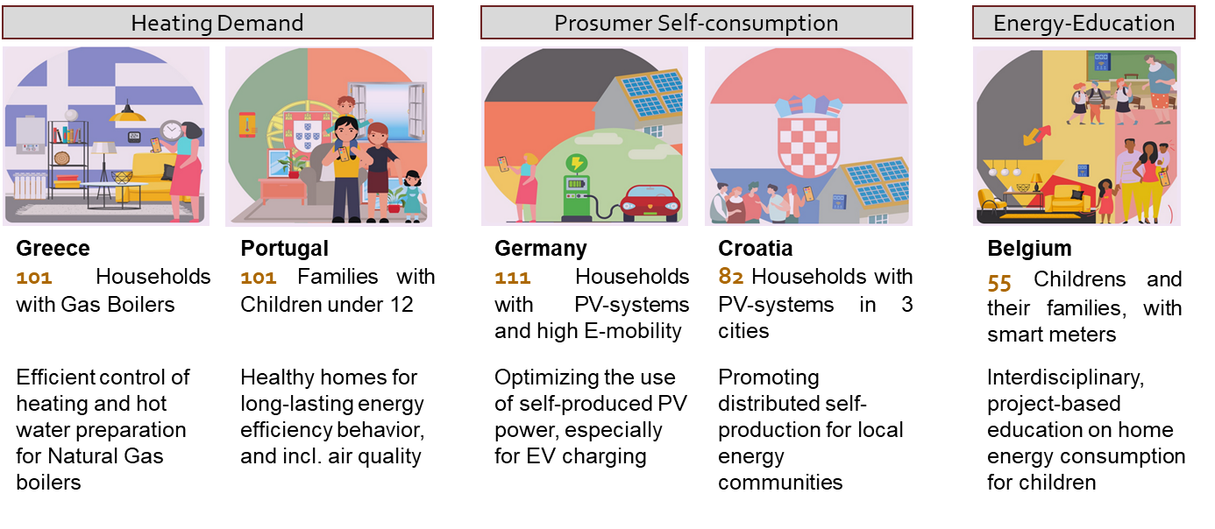
The NUDGE project pilots
Delivery
Smartphone app, web dashboards & smart devices
School courses
Intervention
3 types of nudging interventions
2 cohorts
Data
Sensor data (e.g. energy consumption) + survey data + device data

Slide 9
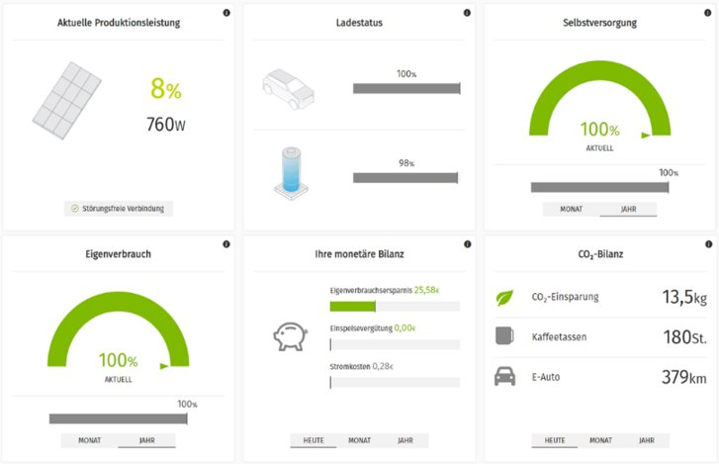
Example: Feedback nudge using information
Feedback nudge:
Households consumers in Germany received information via digital tools (web and app versions), using simple indicators, reference values and color coding

Slide 10
Research protocol to measure the impact of interventions
The NUDGE project used a blend of advanced and adaptable methods to evaluate nudges' effectiveness in real-world settings, accounting for the complexities of everyday life
Randomised Control Trials to compare how energy use changed over time in different groups – those exposed to nudges and the control group.
The principal analytic method (Difference-in-Differences) is good at distinguishing the effect of nudges from other parameters such as weather changes or different home setups.
Adjusted methods to deal with practical challenges with data gaps or changes in the group of participants.
NUDGE used sensor data for actual effects and surveys for perceived effects; and combined these to evaluate nudges' effectiveness.
Sensor Data: Collected from devices like smart meters to measure actual changes in energy use.
Survey Data: Collected from participants to understand their perceptions and reported behaviors.
App Data: Collected from mobile applications, indicating user engagement

Slide 11
Analytic methods to measure the impact of interventions
Difference-in-Differences (DiD) Analysis: compares energy use changes over time and between groups (with and without nudges), effectively isolating the impact of nudges by accounting for external influences like weather.
Two-way-fixed effects (TWFE) Analysis: controls for variations in data across different households and over time, stabilizing results by removing unrelated variables, although it may not fully adjust for all non-uniform differences.
Within-Subject Comparison: applied when continuous sensor data isn’t available, or there are challenges with the study design.
More statistical methods used for analyzing meter and survey data (t-tests, k-means, anova, random intercept model) to identify and handle outlier values.
Data gaps handled by aggregating data, using interpolation methods, and accepting some unbalanced datasets

Slide 12
This is not a lab!
The real-life setting of the study presents unique challenges compared to lab experiments, as it involves numerous variables in everyday decision-making .
Technical issues and human behaviors have an impact on the quality and reliability of data.
Field Trial settings introduce challenges like confounding factors, learning effects, and varying data quality.
Results are influenced by external factors, such as the weather, energy prices, the pandemic, and the energy crisis
The randomisation of participants can sometimes lead to unbalanced groups, highlighting the need for representative study groups.
Implementing engagement strategies is essential to maintain participation for the integrity of the study
Need to choose methods that accurately test the impact of the chosen behavioural intervention and consider the specific conditions of each exposure group.
Balance scientific rigor with the practicalities of real-world energy use.

Slide 13
Positive effects from nudging
Energy savings ranged from 3-4% for interactive nudges, up to 16 % for Default nudges for automated consumption optimization (e.g. EV charging).
Participants interacting with apps showed more pronounced nudging effects.

Slide 14
Inconsistent Evidence
There was no consistent evidence supporting the effectiveness of nudges across all country settings.
Confounding factors distorted results (e.g. high prices due to the energy crisis 2022).
In each pilot, some groups/outcomes showed insignificant or contradictory effects.

Slide 15
Barriers to Energy Savings
Limited interaction with apps,
unfavorable time periods (e.g. holidays),
weather effects can be limiting the effectiveness of nudges (e.g. mild winters in BE and GR lessened the need for heating).
Energy literacy is not a guaranteed outcome from nudging.

Slide 16
Recommendations
Choose nudges with immediate response (e.g., defaults) to avoid convoluted links towards behavioral change which can decrease the effectiveness and complicate the monitoring.
01
Align nudges and regulatory incentives [otherwise risk offsetting nudging effects]
02
In field trials, increase the number of households, ensure representative groups, and test fewer interventions.
03
Notes:
Are surveys enough? No. We see different effects between surveys (self-reported intentiosn) and the actual reductions in energy (from smart meters)
Behavioural effects are not easy to distinguish
We can need repeatable experiments with large enough representatvive groups before we establish a reliable method to estimate more reliably the impact of behavioural interventions

